Slide 1
ECON1002 Intro. Macro.
Tutorial 12
Herbert Xin
wei.xin@sydney.edu.au

Slide 2
Plan of Today
Concept Review
Tutorial Questions

Slide 3
Concept Review

Slide 4

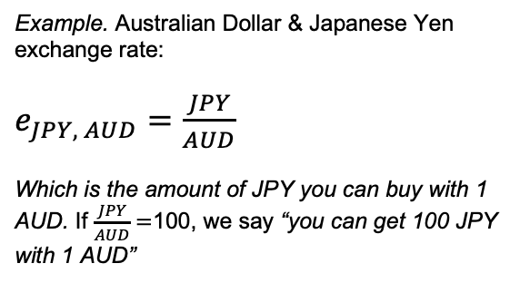

Nominal vs. Real Exchange Rate
Nominal Exchange Rate
Real Exchange Rate
The relative value between two currencies
The price of average domestic goods in terms of the average foreign goods
Example. Australian Dollar & Japanese Yen exchange rate:
$e_{JPY, AUD}=\frac{JPY}{AUD}$
Which is the amount of JPY you can buy with 1 AUD. If $\frac{JPY}{AUD}=$100, we say “you can get 100 JPY with 1 AUD”
$$q≡e⋅\frac{P}{P^{f}}$$
This equation reads “the real exchange rate is equivalent of nominal exchange rate times the relative price level between two countries”
We can re arrange this equation to make more sense
$$q≡e⋅\frac{P}{P^{f}}=\frac{JPY}{AUD}⋅\frac{P_{aus}}{P_{jp}}=\frac{JPY}{P_{jp}}/\frac{AUD}{P_{aus}}$$
The real relative value between two currencies
$\frac{JPY}{P_{jp}}$ is the real value of JPY, $\frac{AUD}{P_{aus}}$ is the real value of AUD

Slide 5
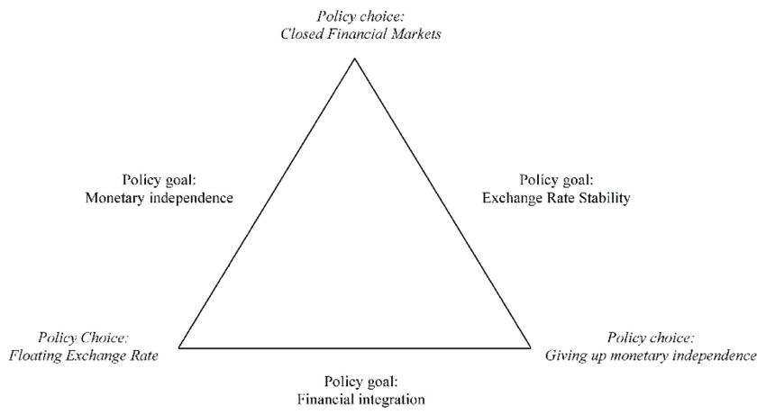
Purchasing Power Parity
Law of One Price
Impossible Trinity
The real value of the same good should be the same across countries
Capital flow
Exchange rate
Monetary policy
Assuming transportation cost is low, and arbitrage is possible
Purchasing Power Parity (PPP) Theory
Nominal exchange rate are determined such that law of one price holds.

Slide 6
Tutorial Questions

Slide 7
Question 1
How would each of the following be likely to affect the value of the AUD, all else being equal? Explain.
Australian shares are perceived as having become much riskier financial investments.
European computer firms switch from Australian-produced software to software produced in India, Israel and other nations.
As East Asian economies recover, international financial investors become aware of many new, high-return investment opportunities in the region.

Slide 8
Question 1
How would each of the following be likely to affect the value of the AUD, all else being equal? Explain.
Australian shares are perceived as having become much riskier financial investments.
AUD depreciates as higher risk decreases investors demand on AUD.
European computer firms switch from Australian-produced software to software produced in India, Israel and other nations.
Demand for Australia goods (software) decreases, so demand for AUD decreases, so the value of AUD depreciates.
As East Asian economies recover, international financial investors become aware of many new, high-return investment opportunities in the region.
Investors switch their attention to the East Asian market, which decreases the demand for AUD, AUD depreciates

Slide 9
Question 1
How would each of the following be likely to affect the value of the AUD, all else being equal? Explain.
The Australian government imposes a large tariff on imported automobiles.
The Reserve bank reports that it is less concerned about inflation and more concerned about an impending recession in Australia.
Australian consumers increase their spending on imported goods.

Slide 10
Question 1
How would each of the following be likely to affect the value of the AUD, all else being equal? Explain.
The Australian government imposes a large tariff on imported automobiles.
Australians buy less foreign automobiles, i.e. decreasing the supply of AUD to the global market, AUD appreciates.
The Reserve bank reports that it is less concerned about inflation and more concerned about an impending recession in Australia.
If recession indeed hits, RBA lowers policy rate, making Australian financial assets less attractive, decreasing the demand for AUD, AUD depreciates. This could be offset by another effect of recession, which is lowered demand for foreign goods, which lowers the supply of AUD, leading to AUD appreciating.
Australian consumers increase their spending on imported goods.
Increased demand on imported goods increases supply of AUD to the global market, AUD depreciates.

Slide 11
Question 2
A British-made car is priced at 20,000 pounds and a comparable Australian-made car costs $26,000. One pound trades for $1.50 in the foreign exchange market. Find the real exchange rate for cars from the perspective of Australia and from the perspective of Great Britain. Which country’s cars are more competitively priced?
In AUD
British car costs ￡20,000 ⨉ 1.5 = $30,000
Australian car, on the other hand, costs $26,000
If we assume both cars has then same quality, then Australian car is priced more competitively.
In Pound
Australian car costs $26,000/1.5 = ￡17,333
British car, on the other hand, costs ￡20,000
If we assume both cars has then same quality, then Australian car is still priced more competitively.
Either way, we should find Australian car to be cheaper

Slide 12
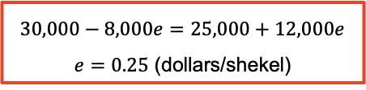

Question 3
The demand for and supply of shekels in the foreign exchange market is
Demand $=30,000−8,000e$
Supply $=25,000+12,000e$
where the nominal exchange rate is expressed as dollars per shekel.
a. What is the fundamental value of shekel?
Fundamental value refers to the price of shekels when there is no shock, i.e. the equilibrium value, so we just solve for the equilibrium price, where demand equals supply.
$$30,000−8,000e=25,000+12,000e$$
$e=0.25$ (dollars/shekel)

Slide 13
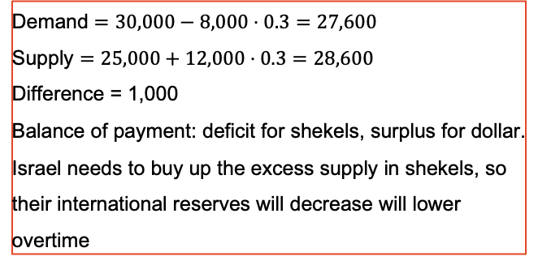
Question 3
The demand for and supply of shekels in the foreign exchange market is
Demand $=30,000−8,000e$
Supply $=25,000+12,000e$
where the nominal exchange rate is expressed as dollars per shekel.
b. The shekel is fixed at $0.30. Is the shekel overvalued, undervalued or neither? Find the balance of payments deficit or surplus in both shekels and dollars. What happens to the country’s international reserves over time?
Now if we find the corresponding demand and supply
Demand $=30,000−8,000⋅0.3=27,600$
Supply $=25,000+12,000⋅0.3=28,600$
Difference = 1,000
Balance of payment: deficit for shekels, surplus for dollar.
Israel needs to buy up the excess supply in shekels, so their international reserves will decrease will lower overtime
From the last question, we know the fundamental value of shekel is 0.25 dollar/shekel, so if shekel is fixed at $0.3, then shekel is over-valued.

Slide 14
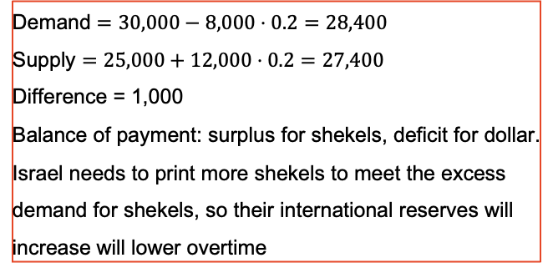
Question 3
The demand for and supply of shekels in the foreign exchange market is
Demand $=30,000−8,000e$
Supply $=25,000+12,000e$
where the nominal exchange rate is expressed as dollars per shekel.
b. Repeat part b. for the case in which the shekel is fixed at $0.20
Now if we find the corresponding demand and supply
From the previous question, we know the fundamental value of shekel is 0.25 dollar/shekel, so if shekel is fixed at $0.2, then shekel is under-valued.
Demand $=30,000−8,000⋅0.2=28,400$
Supply $=25,000+12,000⋅0.2=27,400$
Difference = 1,000
Balance of payment: surplus for shekels, deficit for dollar.
Israel needs to print more shekels to meet the excess demand for shekels, so their international reserves will increase will lower overtime

Slide 15
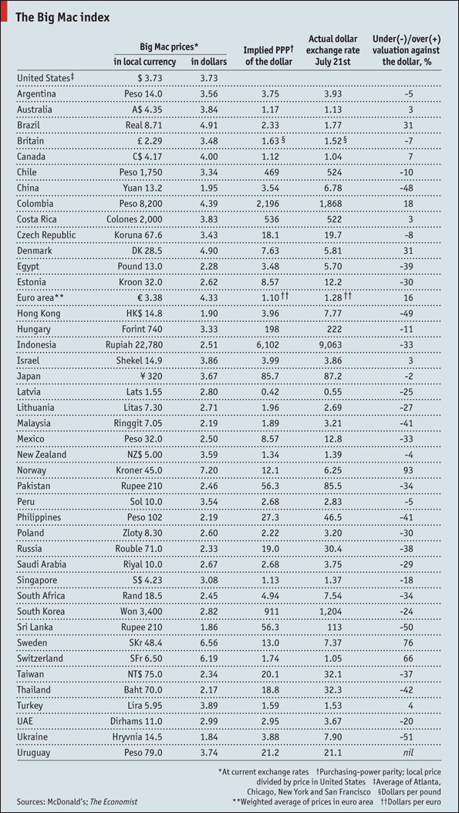
Question 4
Using the table above taken from the Economist, answer the following questions.
a. Explain some of the advantages and disadvantages of the Big Mac index.

Slide 16
Question 4
Using the table above taken from the Economist, answer the following questions.
a. Explain some of the advantages and disadvantages of the Big Mac index.
Advantages:
Big Mac available in many countries
Big Mac is always the same (mostly)
McDonalds holds monopolistic power among most countries
Nice basis the international comparison
Disadvantages:
Burgers are not traded across borders → no arbitrage to ensure law of one price
It’s pricing depends on the price of local ingredients rather than purchasing power of the currency
So it’s pricing mainly reflects local wages and rents, which is non-tradable or not very mobile

Slide 17
Question 4
Using the table above taken from the Economist, answer the following questions.
b. On 21 July 2010, the nominal exchange rate was AUD $1 = USD $0.8850 (1.13). On 8 October 2010, the nominal exchange rate was AUD $1 = USD $0.9835 (1.02). Suppose currency speculators read The Economist. Can you explain this change in the nominal exchange rate? Discuss.
From the table, AUD is overvalued, 1 USD = 1.13 AUD, but 1 USD can buy 1.17 AUD worth of good, so AUD is over-valued.
On 8 Oct 2010, AUD is even more over-valued, now 1 USD = 1.02 AUD.
This implies there is some shock made AUD over-valued in the short-run, but when price starts to adjust in the long-run, AUD should no longer be over-valued.
The table shows price per 21st July 2010

Slide 18
Questions?

